Slide 1
Curriculum Proposal Process New Major, Sequence or Minor
Proposal questions should be directed to CurriculumForms@ilstu.edu
Refer to the Curriculum website for additional resources: https://curriculum.illinoisstate.edu/procedures/

Slide 2
First Steps
There are steps that need to be taken before a new sequence proposal is started. Visit the Provost’s Office website and review the information about Development of New Academic Programs https://provost.illinoisstate.edu/planning/changes/programs/
Complete the Financial Implication Form https://provost.illinoisstate.edu/planning/changes/programs/#FIF
This form is not part of the Curriculum Forms System but is a required document that must be approved and ultimately attached to the curriculum proposal.
Questions about the Financial Implication Form should be directed to the Provost’s Office

Slide 3
The Proposal
Login to Curriculum Forms https://registrar.illinoisstate.edu/curriculumforms/
If a box does not appear for you to enter your User Name and Password, disable the "pop-up blocker" feature of your internet browser.
Use your Illinois State email address (e.g. rredbird@ilstu.edu) as the username and your email password to login.
You can also prefix your ULID with "adilstu\" (e.g. adilstu\rredbird) as the username. Some browsers allow the use of your ULID only.
If prompted for a Domain use "adilstu" and only your ULID as the username.
Select New Program from the top navigation
Select either Create Undergraduate or Graduate Proposal
You should have at least one coauthor for each proposal so that more than one person in a department/school has the ability to access and edit the proposal

Slide 4
The Proposal
Check the appropriate option: New major, sequence or minor
If the program proposal is to be associated with a course proposal, a course added to a program as required or as an elective, the online program proposal must be started before the online course proposal(s) for the system to associate them
Review curriculum deadlines and consider the approval levels/curriculum committees the proposal must go through when selecting the Proposed Starting Catalog Year. The UCC secretary may move the starting catalog year to a later catalog year if necessary. https://curriculum.illinoisstate.edu/forms/deadlines/
Deadlines are when the proposal must arrive at the Graduate Curriculum Committee or University Curriculum Committee status in the Curriculum Forms System. Submit proposals early to allow sufficient time for required approval routing.

Slide 5
The Proposal
Check the appropriate option: New major, sequence or minor
If the program proposal is to be associated with a course proposal, a course added to a program as required or as an elective, the online program proposal must be started before the online course proposal(s) for the system to associate them
Review curriculum deadlines and consider the approval levels/curriculum committees the proposal must go through when selecting the Proposed Starting Catalog Year. The UCC secretary may move the starting catalog year to a later catalog year if necessary. https://curriculum.illinoisstate.edu/forms/deadlines/
Deadlines are when the proposal must arrive at the Graduate Curriculum Committee or University Curriculum Committee status in the Curriculum Forms System. Submit proposals early to allow sufficient time for required approval routing.

Slide 6
The Proposal
You should have at least one coauthor for each proposal
Refer to the current Undergraduate Catalog or Graduate Catalog for how an existing catalog copy is formatted and what information is needed including:
For example, new sequences must indicate the major the sequence is associated with
The degree option(s): B.A. and/or B.S. – if you are proposing a new sequence, check the existing major/sequences for the approved degree options
A general description– for the main department/school page of the catalog Undergraduate Example: https://illinoisstate.edu/catalog/undergraduate/creative-technologies/#audio-music-production Audio and Music Production Sequence
The Audio and Music Production sequence provides concentrated study in sound recording, audio production, sound design, music composition, theory, and business and entrepreneurship practices, along with a host of elective experiences across a range of creative/technical fields including video, sound, electronic music, music production, gaming, motion graphics, interactivity, AR/VR, UI/UX, mobile, web, and computer programming concepts.

Slide 7
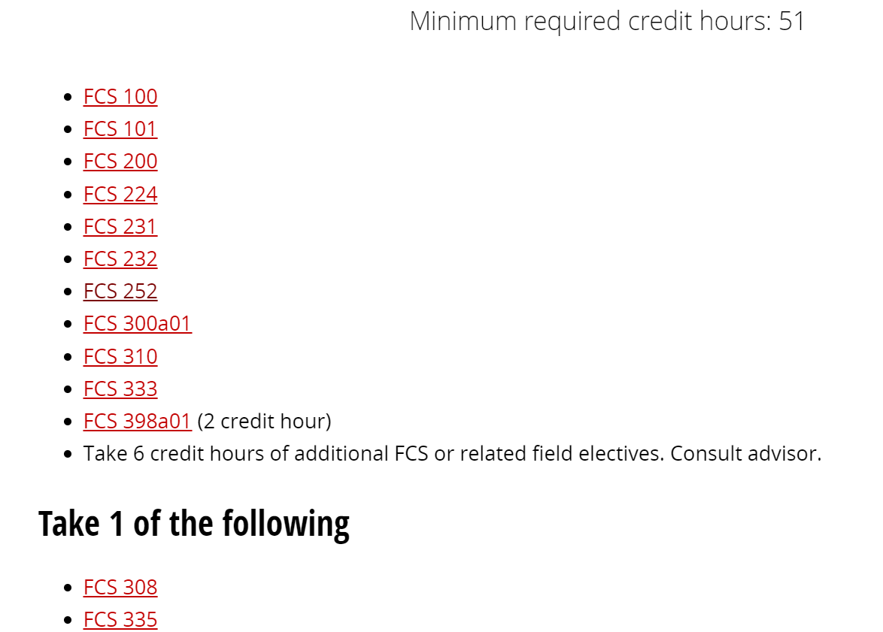
The Proposal
Minimum required credit hours refer to this page for how to count minimum required hours (unique situations for required math courses’ prerequisites and foreign language courses) https://curriculum.illinoisstate.edu/procedures/operating-procedures/#number-of-hours
List all required courses in the correct format. All course prerequisites must be listed as required courses too. Refer to your current catalog copy for examples.

Slide 8
The Proposal
New Accelerated Master’s Degree program proposals
Refer to https://curriculum.illinoisstate.edu/procedures/operating-procedures/#accelerated-programs for a description of these types of programs
Each program must decide how many, if any, credits will count toward both the undergraduate major and the graduate degree. Students may share up to 12 hours or 33% of course work (whichever is higher) between the undergraduate and graduate degrees. Individual programs may allow fewer shared hours if so desired. The undergraduate sequence course requirements must list the undergraduate and graduate course requirements and/or graduate course options/electives.
Programs should consider a minimum number of hours the student must complete in order to graduate from the accelerated sequence. The term ”accelerated” will appear on the undergraduate transcript.
A statement like this one, must appear in the catalog copy: See an example: https://illinoisstate.edu/catalog/undergraduate/marketing/advanced-marketing-analytics-accelerated-course-requirements/ To graduate in this sequence, a student must take at least one course for graduate credit during the senior year. Up to 12 hours of approved graduate courses may be taken that will count for both the undergraduate and graduate program. The student must consult with an advisor and the instructor prior to the start of each new course to ensure approval.

Slide 9
The Proposal
If the major, sequence or minor will require courses outside of your department/school, you must get approval from the department/school chair and attach the email with their approval noted to the new sequence proposal
Attach supporting documents for the proposal by using the Upload File section of the proposal form:

Slide 10
Sample Plans of Study for Undergraduate Majors and Sequences
Each major and sequence must have a sample plan of study as part of the required catalog copy
Review an existing major or sequence’s sample plan of study as a guide for the format to use https://illinoisstate.edu/catalog/undergraduate/family-consumer-sciences/dietetics-course-requirements/plan/
Address all appropriate graduation requirements:
Total hours required (120 credit hours)
Senior College hours (40 credit hours – this is a change as of the 2024-2025 catalog)
Sample plans of study are part of the catalog copy; future revisions must be made by submitting an Editorial Request in the Curriculum Forms System. Changes are approved for the upcoming catalog year.

Slide 11
Sample Plans of Study for Undergraduate Majors and Sequences
ISU General Education Program https://illinoisstate.edu/catalog/undergraduate/general-education/program/
AMALI https://illinoisstate.edu/catalog/undergraduate/amali/
IDEAS https://illinoisstate.edu/catalog/undergraduate/ideas/
Bachelor of Science - one additional science, mathematics, statistics, and/or technology course (beyond the General Education requirements https://illinoisstate.edu/catalog/undergraduate/bs-smt-grad-req/
College of Arts and Sciences world language requirement https://illinoisstate.edu/catalog/undergraduate/arts-sciences-foreign-language/
Bachelor of Arts foreign language requirement https://illinoisstate.edu/catalog/undergraduate/ba-grad-req/

Slide 12
Proposal Approval Routing
Department/school curriculum committee and chair
College curriculum committee and College Dean
If it is a program that leads to teacher certification it must be reviewed and approved by the Council for Teacher Education
After the College Curriculum Committee and College Dean (and if required CTE or CGE) have approved the program proposal, it will be electronically routed to the University Curriculum Committee Secretary for technical review, campus circulation and consideration by the University Curriculum Committee or Graduate Curriculum Committee.
Academic Senate
Provost
Proposals for new majors must be approved by the Illinois Board of Higher Education (this is why the deadline for new programs/majors is January the year prior to the proposed starting catalog year. The deadline is when the proposal is at the University Curriculum Committee or the Graduate Curriculum Committee status

